Slide 1
Uber Eats
João Gonçalves - up201806162
Pedro Coelho - upxxxxxxxxx

Slide 2
Problem Description
This project tackles the problem of the alocation of deliverers to orders in a food ordering system. Clients may have preference in what they prioritize, beeing it either the delivery cost or the delivery time. This beeing said the client engages in negotiation with the available drivers until a driver is allocated.

Slide 3
Variables
Independent variables: Deliverer speed, deliverer cost per distance unit, deliverer fuel.
Dependent variables: Delivery time, delivery cost.

Slide 4
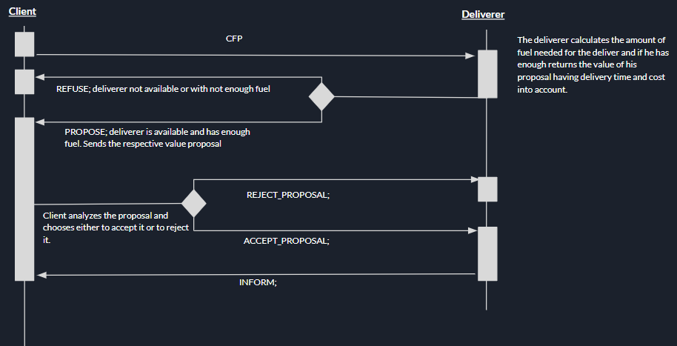
Protocols and interaction

Slide 5
Strategies
We decided to implement 3 types of client strategies evaluating the proposals in a different manner considering their preferences.
The 3 client types are:
- Cost focused: attributes all proposal value to the cost of the delivery, disregarding delivery time.
- Time focused: attributes all proposal value to the time that it takes to conclude the delivery, disregarding delivery cost.
- Balanced: Attributes similar value to both parameters.

Slide 6
Agent Creation

Slide 7
Experiments

Slide 8
Result Analysis

Slide 9
Adicional Slides

Slide 10
Implemented Classes

Slide 11
Execution example (possivelmente Podemos meter este slide na apresentacao)

